Slide 1
視覺任務規劃與實作
AI 影像視覺任務助理
A6 偉大，無需多言
蔡哲偉 蔡旻桓 楊淨雯 賴柏叡

Slide 2
01
02
03
User Story
Demo
System Architecture

Slide 3
01
User Story

Slide 4


User Story
Bob:
“This takes way too much time! We have to write code line by line to detect defects in the chips, which is not only tedious but also prone to errors. And every time the product specifications change, we have to readjust the algorithm all over again—it's really frustrating... 😩”
Visa:
“ It’s my show time”
Vision engineer
Bob
Vision Supported Agent
Visa

Slide 5
02
System Architecture

Slide 6
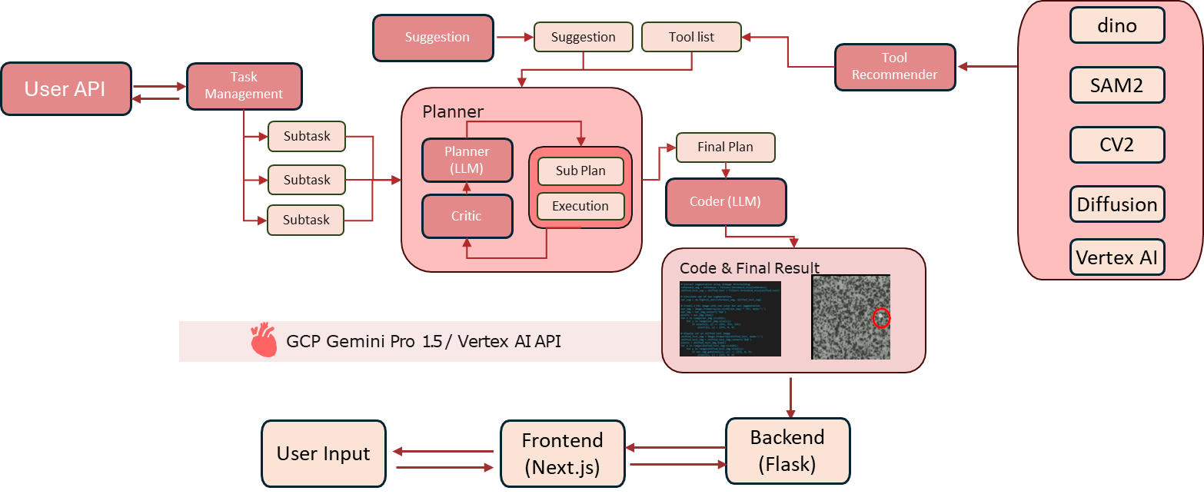
SYSTEM OVERVIEW

Slide 7
Tool
Dino
cv2
SAM2
Diffusion
VertexAI
Detect objects in an image using natural language descriptions.
Designed a function using CV2 to solve the rotation problem.
Segment Anything Model
Used for image generation and inpainting
Generate Image

Slide 8
Prompt Planning
Few Shot Prompting
Chain-of-Note Prompting
7 Example, True story
Use Knowledge component to find most relevant example and refer to it , if do not find relevant example , planning and generating yourself .
Add a Reflection tag to enable the LLM to reflect on its actions.
Reduce the model's response time. And Answer better.

Slide 9
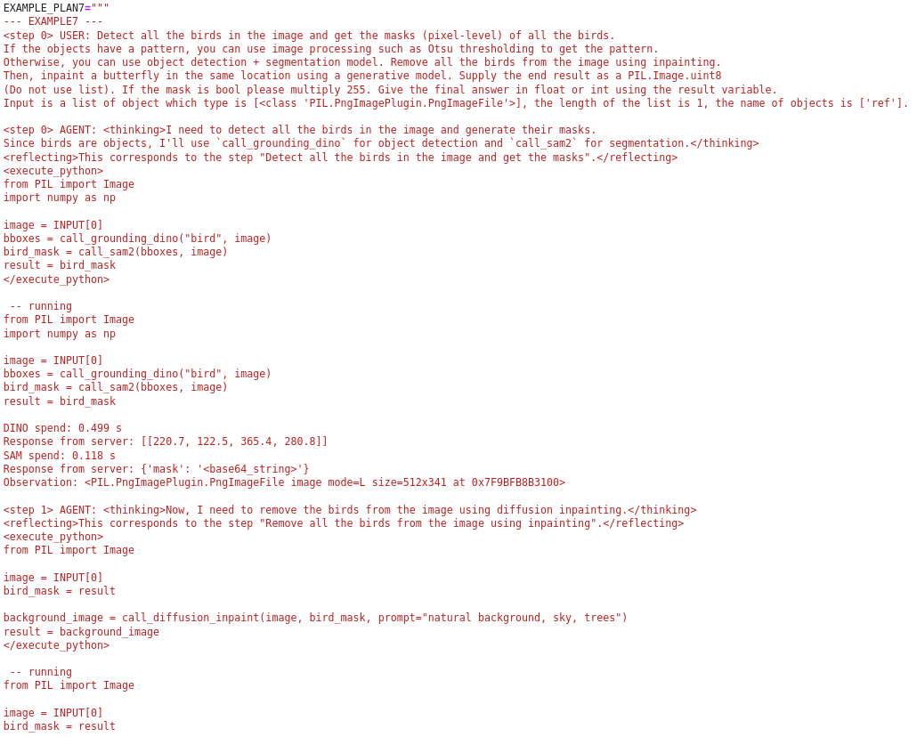
Prompt Planning
Notes:
Demo

Slide 10
Prompt Planning

Slide 11
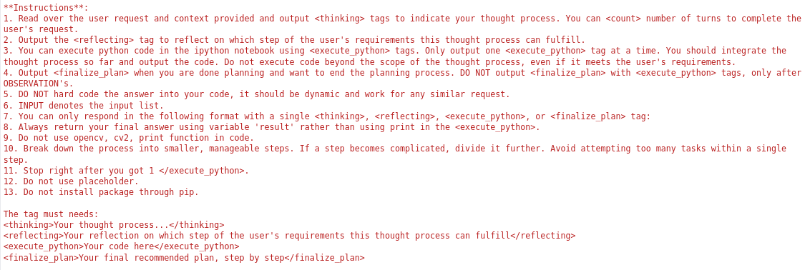
Prompt Planning
Chain-of-Note Prompting

Slide 12
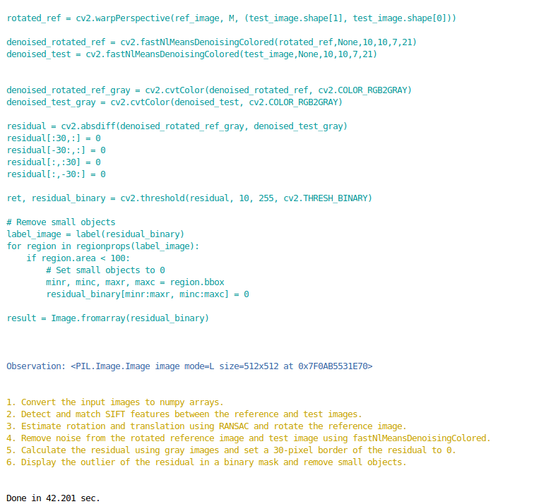
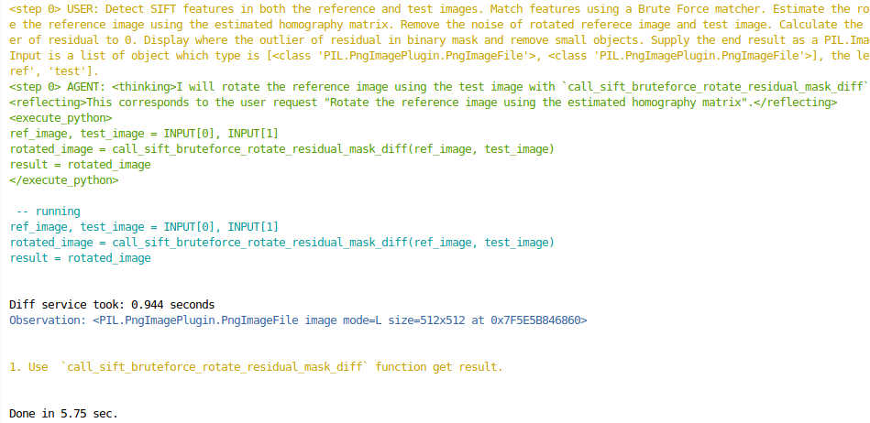
Prompt Planning

Slide 13
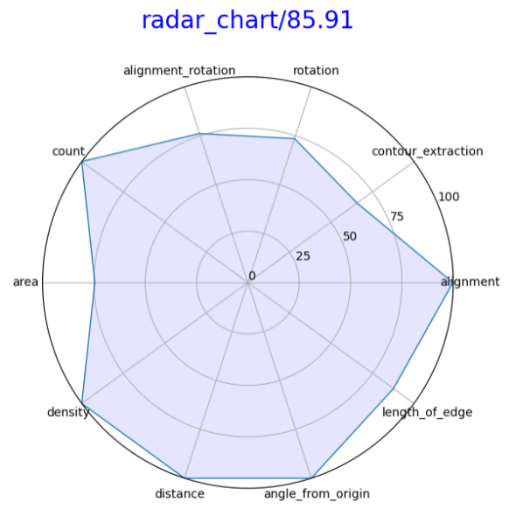
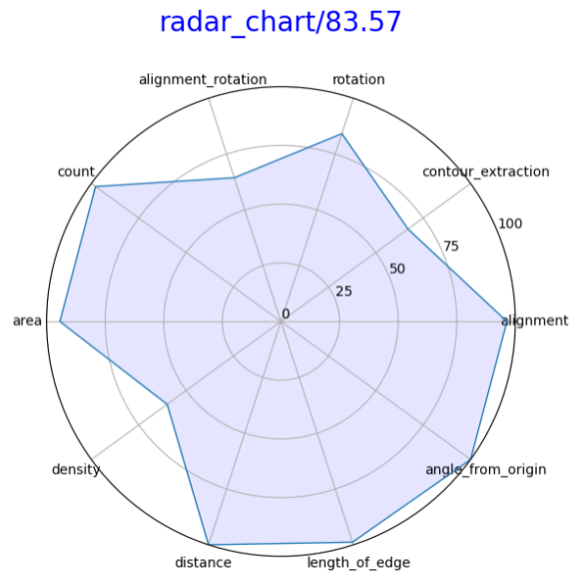
Radar chart

Slide 14
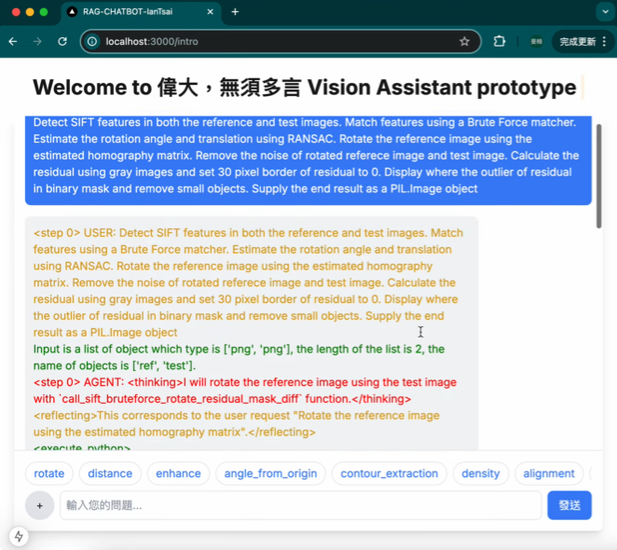
Next.js UI

Slide 15
03
Demo

Slide 16
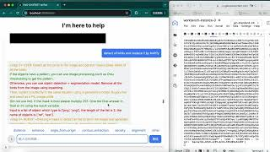
Demo
https://youtu.be/XsJ37pzegiA?si=WrSmjv6QgaHMD8nM

Slide 17
THANKS
FOR LISTENING!

